Slide 1
Assignment #7 (Machine Learning)
Javier Salazar
1001144647

Slide 2
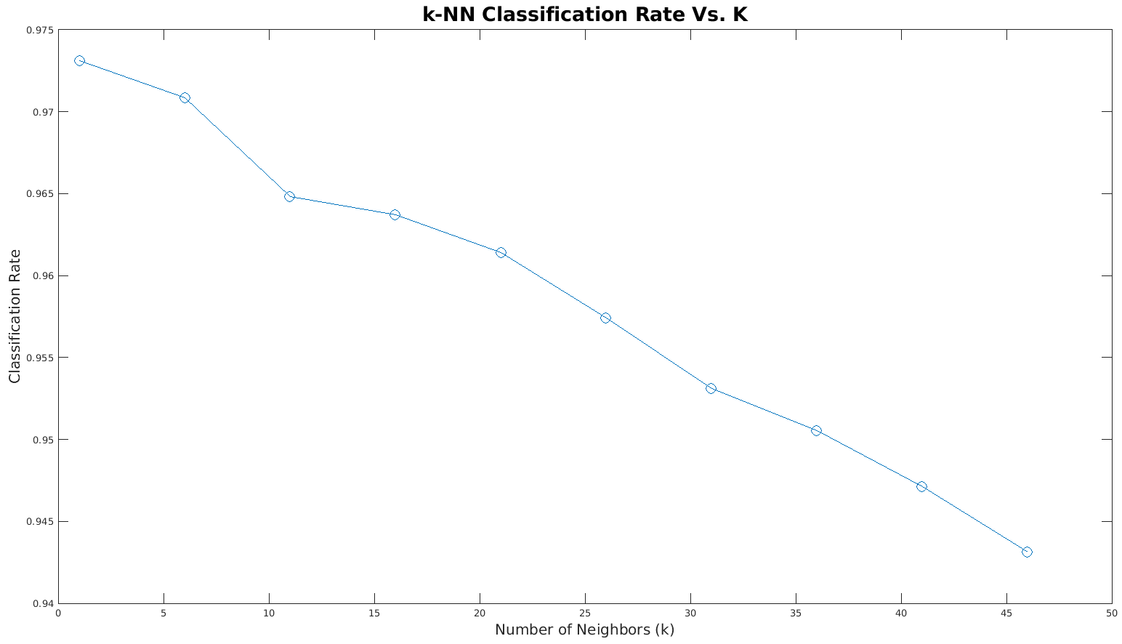
Results

Slide 3
Results
Classification Rate Vs # of Neighbors
K Neighbors | Classification Rate
1 | 0.9731
2 | 0.9680
3 | 0.9731
4 | 0.9711
5 | 0.9706
10 | 0.9666
50 | 0.9403
100 | 0.9037
500 | 0.7879
1000 | 0.6738

Slide 4
Analysis
The script ‘singleK.m’ is for running one specific run of k neighbors
The script ‘script_nearest.m’ is for generating a plot of classification rates given the vector for k=1:5:50 for example
No overfitting occurs since there are 7,500 training points so the data is dense thus leading to high classification rate with low k
Highest rate: 97.3%. Better than the multi-layer perceptron network at classifying hand written digits (91%)

